Slide 1

Room Occupation Estimator
EEET2485 Research Method For Engineers- 2022 A
Lecturer: Dr. Son Vu Truong Dao
GROUP 10
Nguyen Dang Huynh Chau (s3777214)
Truong Phu Khang (s3814172)
Le Anh Quan (s3777351)

Slide 2
Team
Nguyen Dang Huynh Chau Leader
Truong Phu Khang
Member
Le Anh Quan
Member

Slide 3

Agenda
Research Question:
List all research questions
Data Analysis:
Outliers
Analyze correlations between each parameter.
Analyze room occupancy condition.
Analyze room occupancy in different conditions
Conclusion

Slide 4

Research Question
Correlation:
Correlations between parameters
Main factor:
Main factors?
How it affect room occupancy?

Slide 5

Data Analysis:

Slide 6
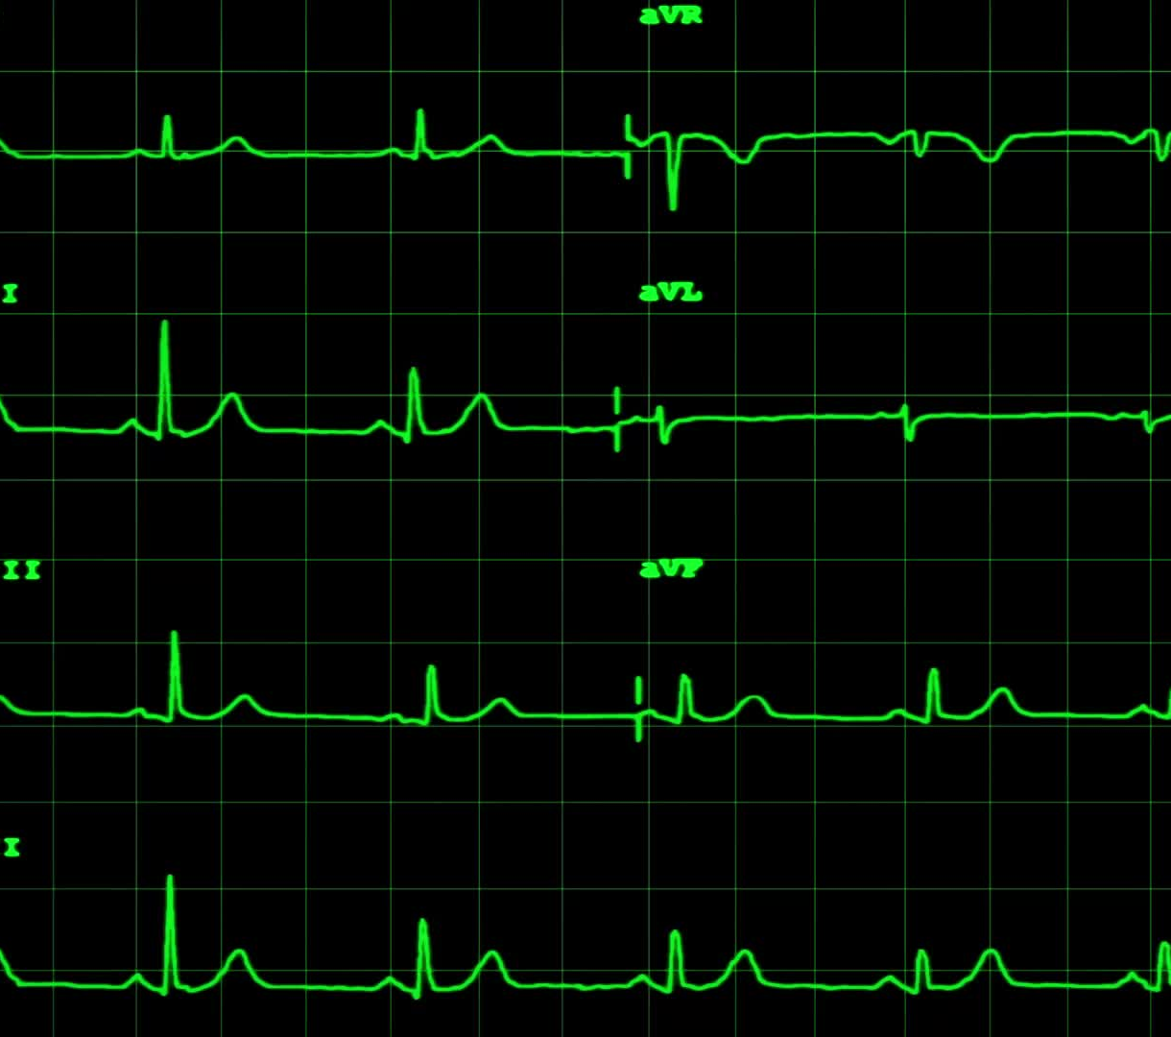
Dealing with outliers
Method:
IQR
How:
Below 6%: delete all
Over 6%: delete them if they are noise data
Boxplot

Slide 7
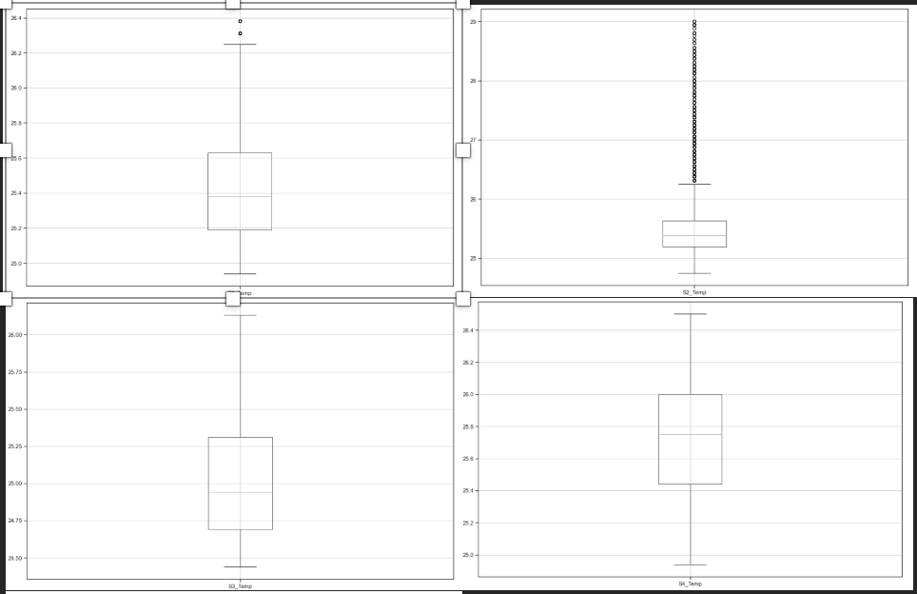
Outlier For Temperature

Slide 8
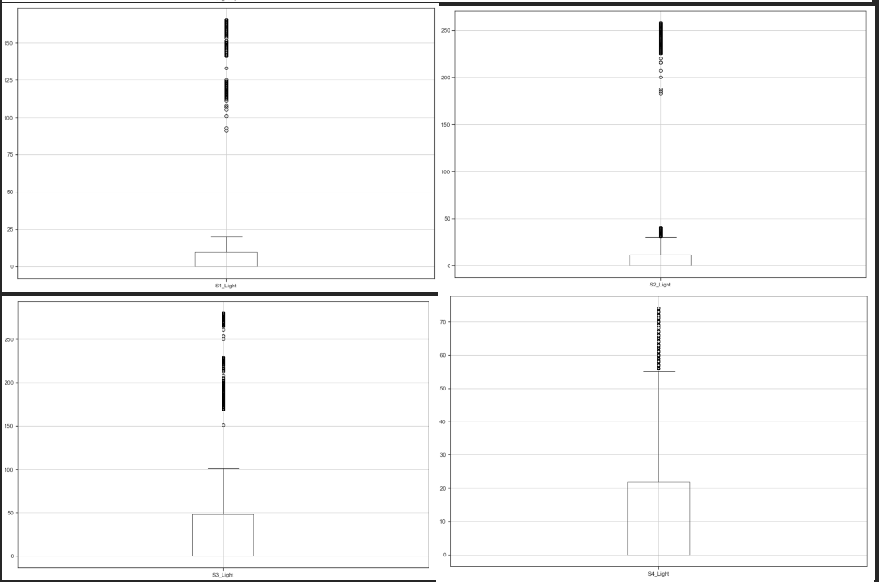
Outlier For Light

Slide 9
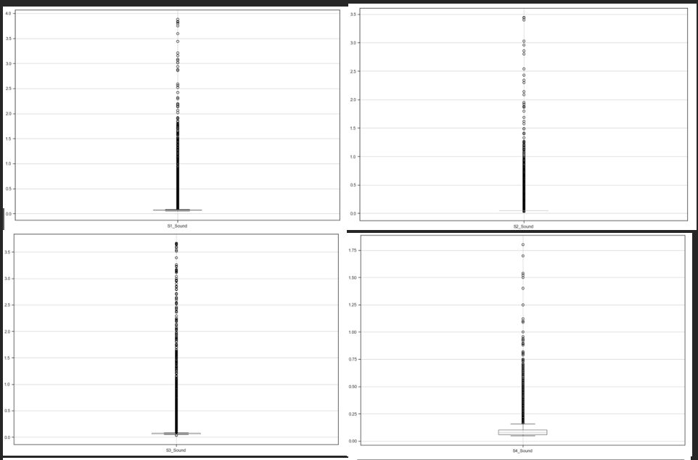
Outlier of Sound

Slide 10
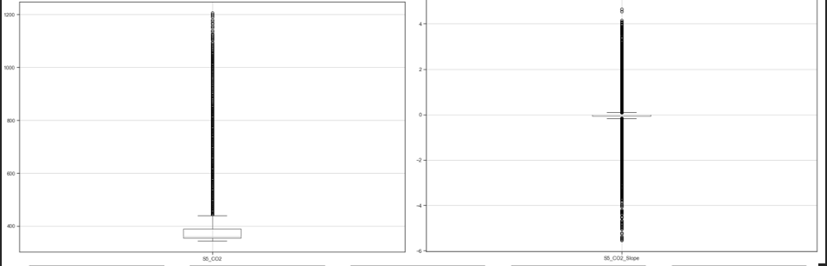
Outlier For CO2

Slide 11
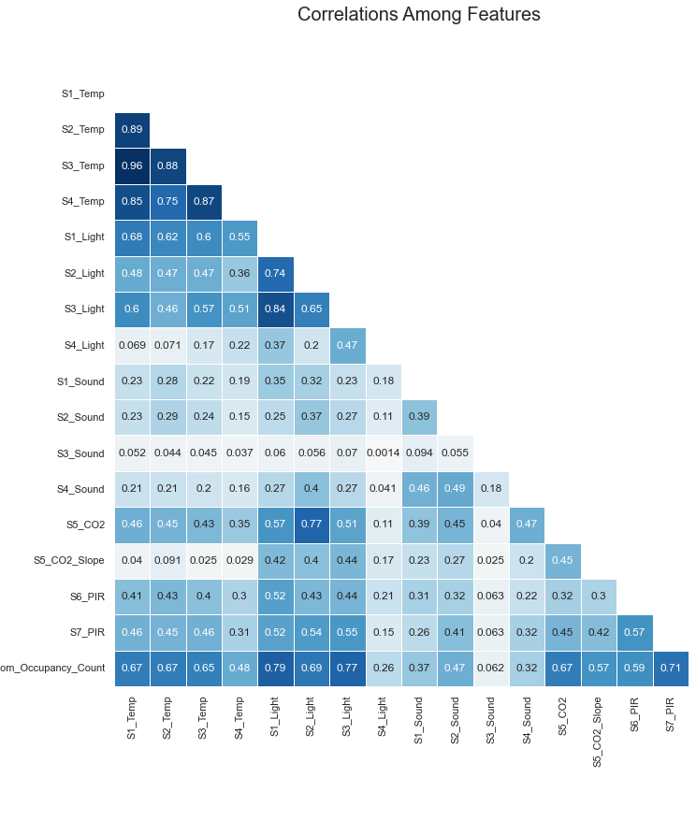
Correlation between features

Slide 12
Correlation between Features
Method:
Heatmap
How:
Set hypothesis, significant level = 0.05
Spearman’s rho

Slide 13
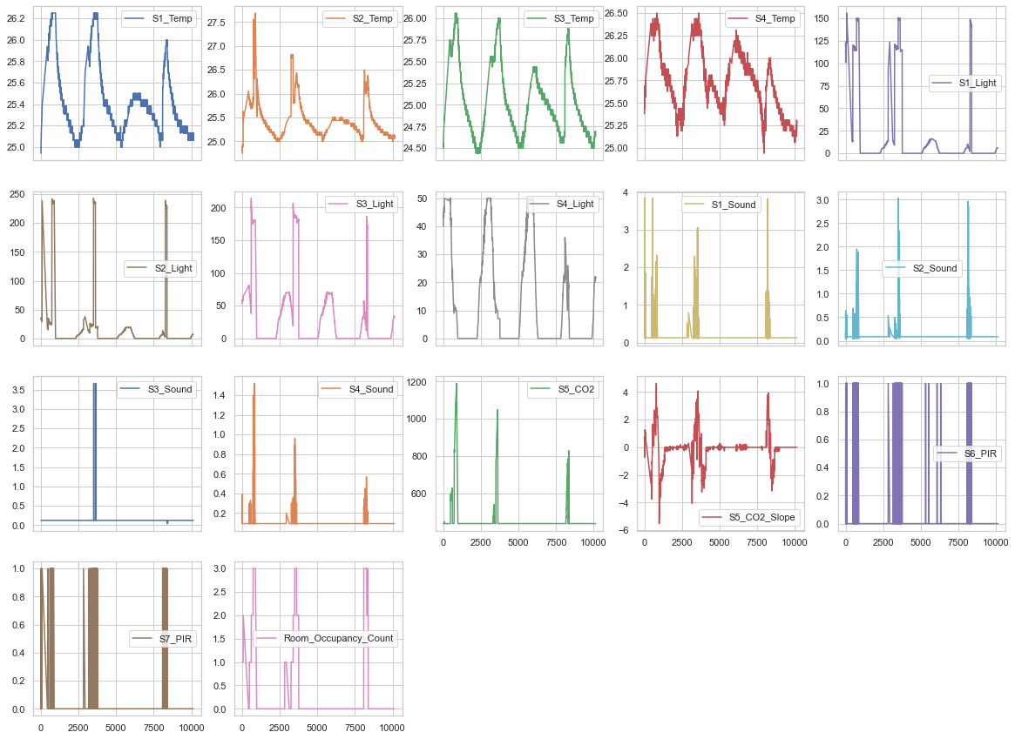
Data Distribution

Slide 14
Result
Correlation between temperature, sound, light, CO₂ and PIR

Slide 15
Analyze Room Occupancy Condition
Method:
Querying Statistic
Factor Analysis
Result:
S1_Light
S5_CO₂
Decision Tree

Slide 16
Query Table by Time
 | Morning | Lunch | Night
S1_Temp | 25.121092 | 25.839359 | 25.596552
S1_Light | 6.996829 | 64.792399 | 3.080726
S1_Sound | 0.140311 | 0.240026 | 0.129655
S5_CO2 | 439.704236 | 527.559279 | 439.693341
S6_PIR | 0.011628 | 0.250709 | 0.009387
Room_Occupancy_Count | 0.029598 | 1.254112 | 0.053817

Slide 17
Query Table by Date
Date | S1_Temp | S1_Light | S1_Sound | S5_CO₂ | S6_PIR | Room_Occupancy_Count
2017/12/22 | 25.799904 | 55.510117 | 0.236405 | 507.879225 | 0.172524 | 0.757188
2017/12/23 | 25.502446 | 28.025031 | 0.161957 | 466.136322 | 0.066475 | 0.409110
2017/12/24 | 25.241823 | 0.954887 | 0.129655 | 439.693341 | 0.000000 | 0.000000
2017/12/25 | 25.350613 | 3.936554 | 0.129655 | 439.693341 | 0.004326 | 0.000000
2017/12/26 | 25.237902 | 0.895579 | 0.129655 | 439.693341 | 0.000000 | 0.000000
2018/01/10 | 25.573139 | 17.186560 | 0.175660 | 466.243470 | 0.177533 | 0.791374
2018/01/11 | 25.151164 | 0.793893 | 0.129655 | 439.693341 | 0.000000 | 0.000000

Slide 18
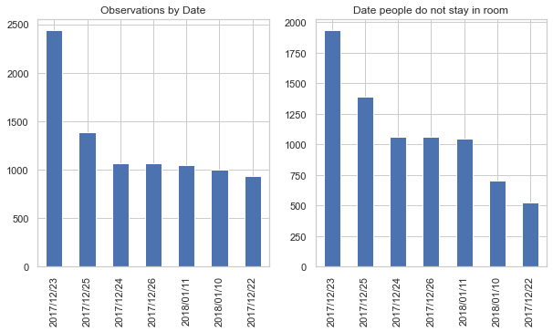
Query data by date

Slide 19
Testing
Bartlett’s test:
(26487.711031542083, 0.0)
Kaiser-Meyer-Olkin (KMO) Test:
0.83

Slide 20
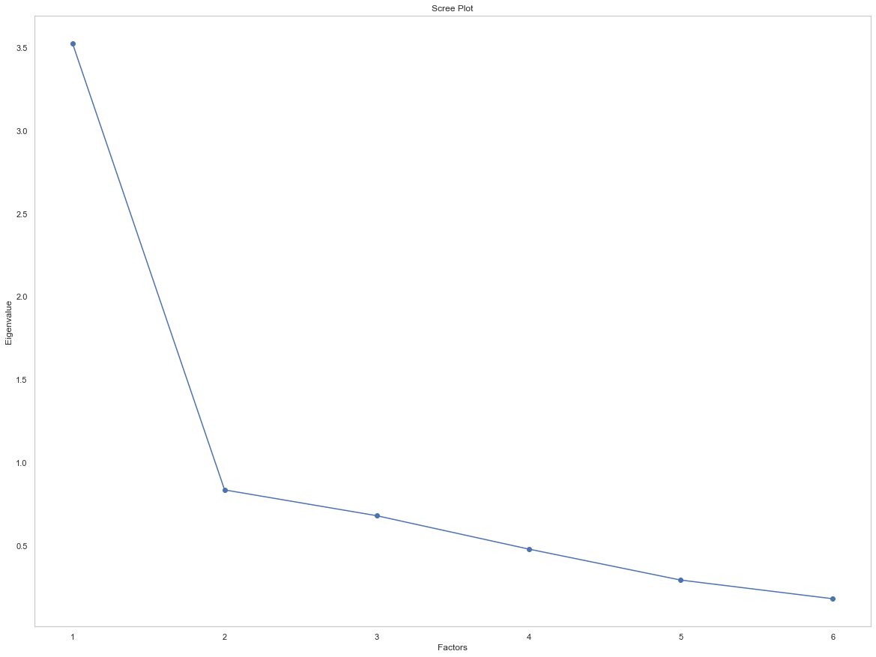
ScreePlot

Slide 21
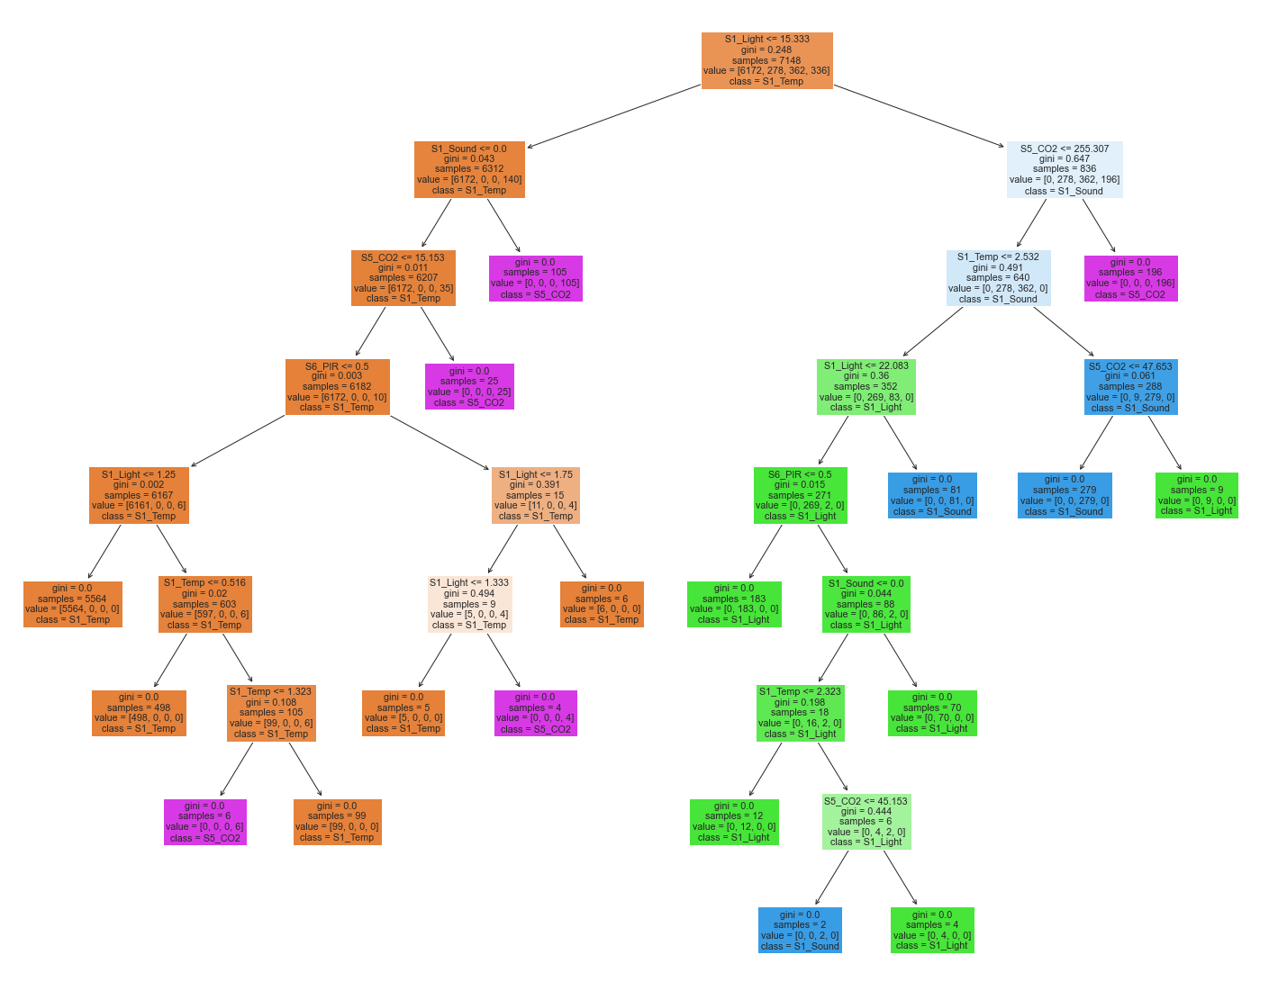
Train model to test

Slide 22
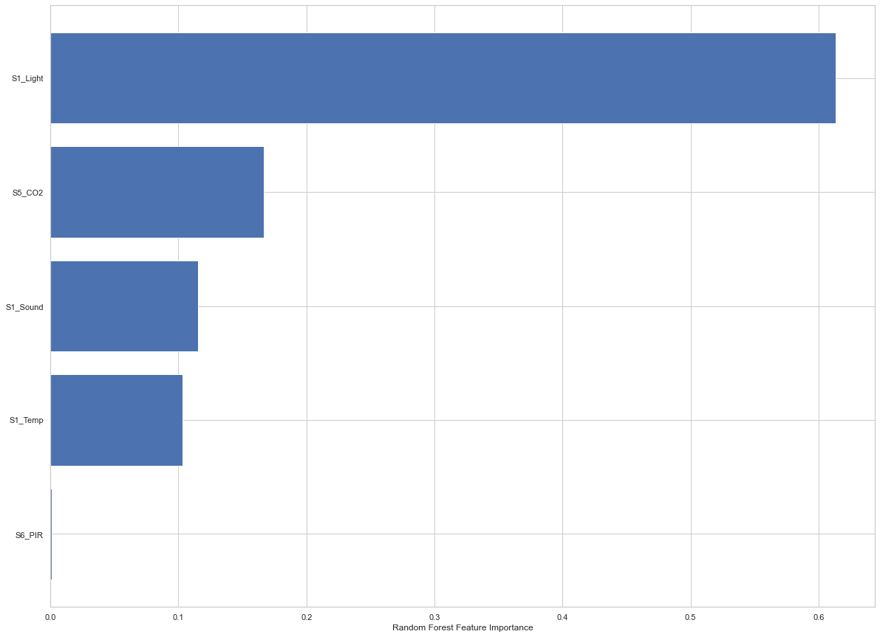
Extract the Feature Important

Slide 23
Main factor affect the room occupancy
Method:
3 Plots
Result:
S1_Light $≠expected$
S1_Light ≠𝑒𝑥𝑝𝑒𝑐𝑡𝑒𝑑
Mann-Whitney testing
S5_CO₂ $≠expected$
S5_CO₂ ≠𝑒𝑥𝑝𝑒𝑐𝑡𝑒𝑑

Slide 24
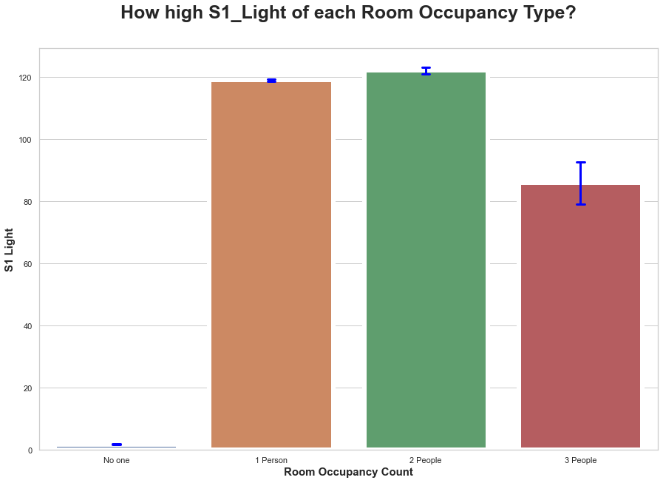
S1_Light

Slide 25
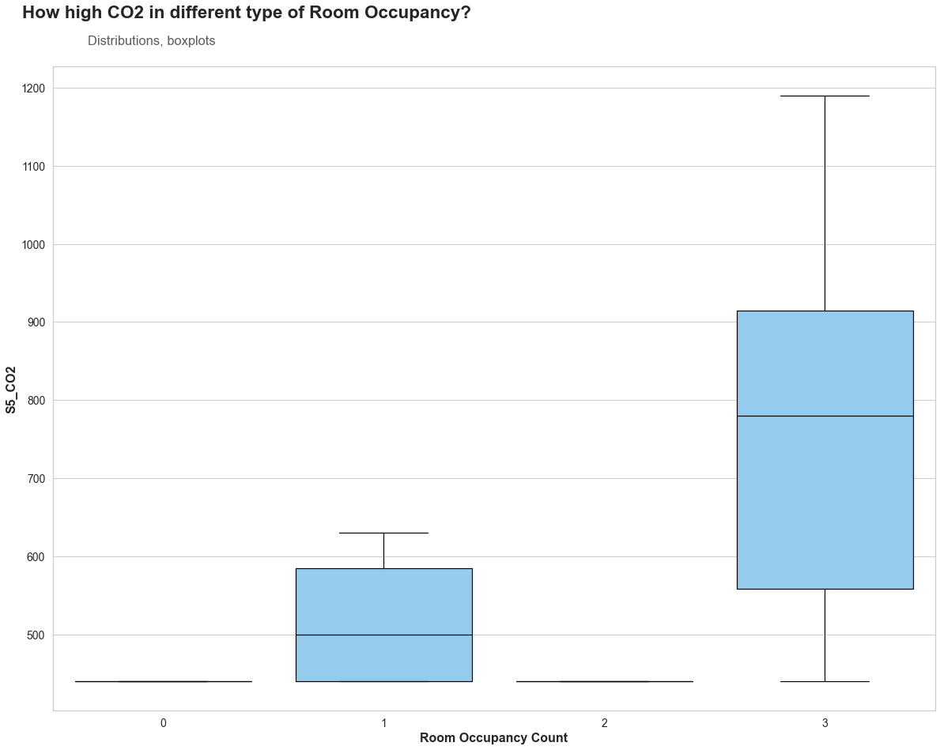
S5_Co₂

Slide 26
Statistical Test
Method:
Mann-Whitney testing
Result:
higher temperature
higher light

Slide 27



Conclusion
Outliers:
IQR
Boxplot
Correlation between features.
Spearman’s rho
Heatmap
Main factors in predicting room occupancy:
Factor analysis
Decision Tree
How main factors affect:
Plots
Mann-Whitney testing

Slide 28

THANK YOU

